Slide 1

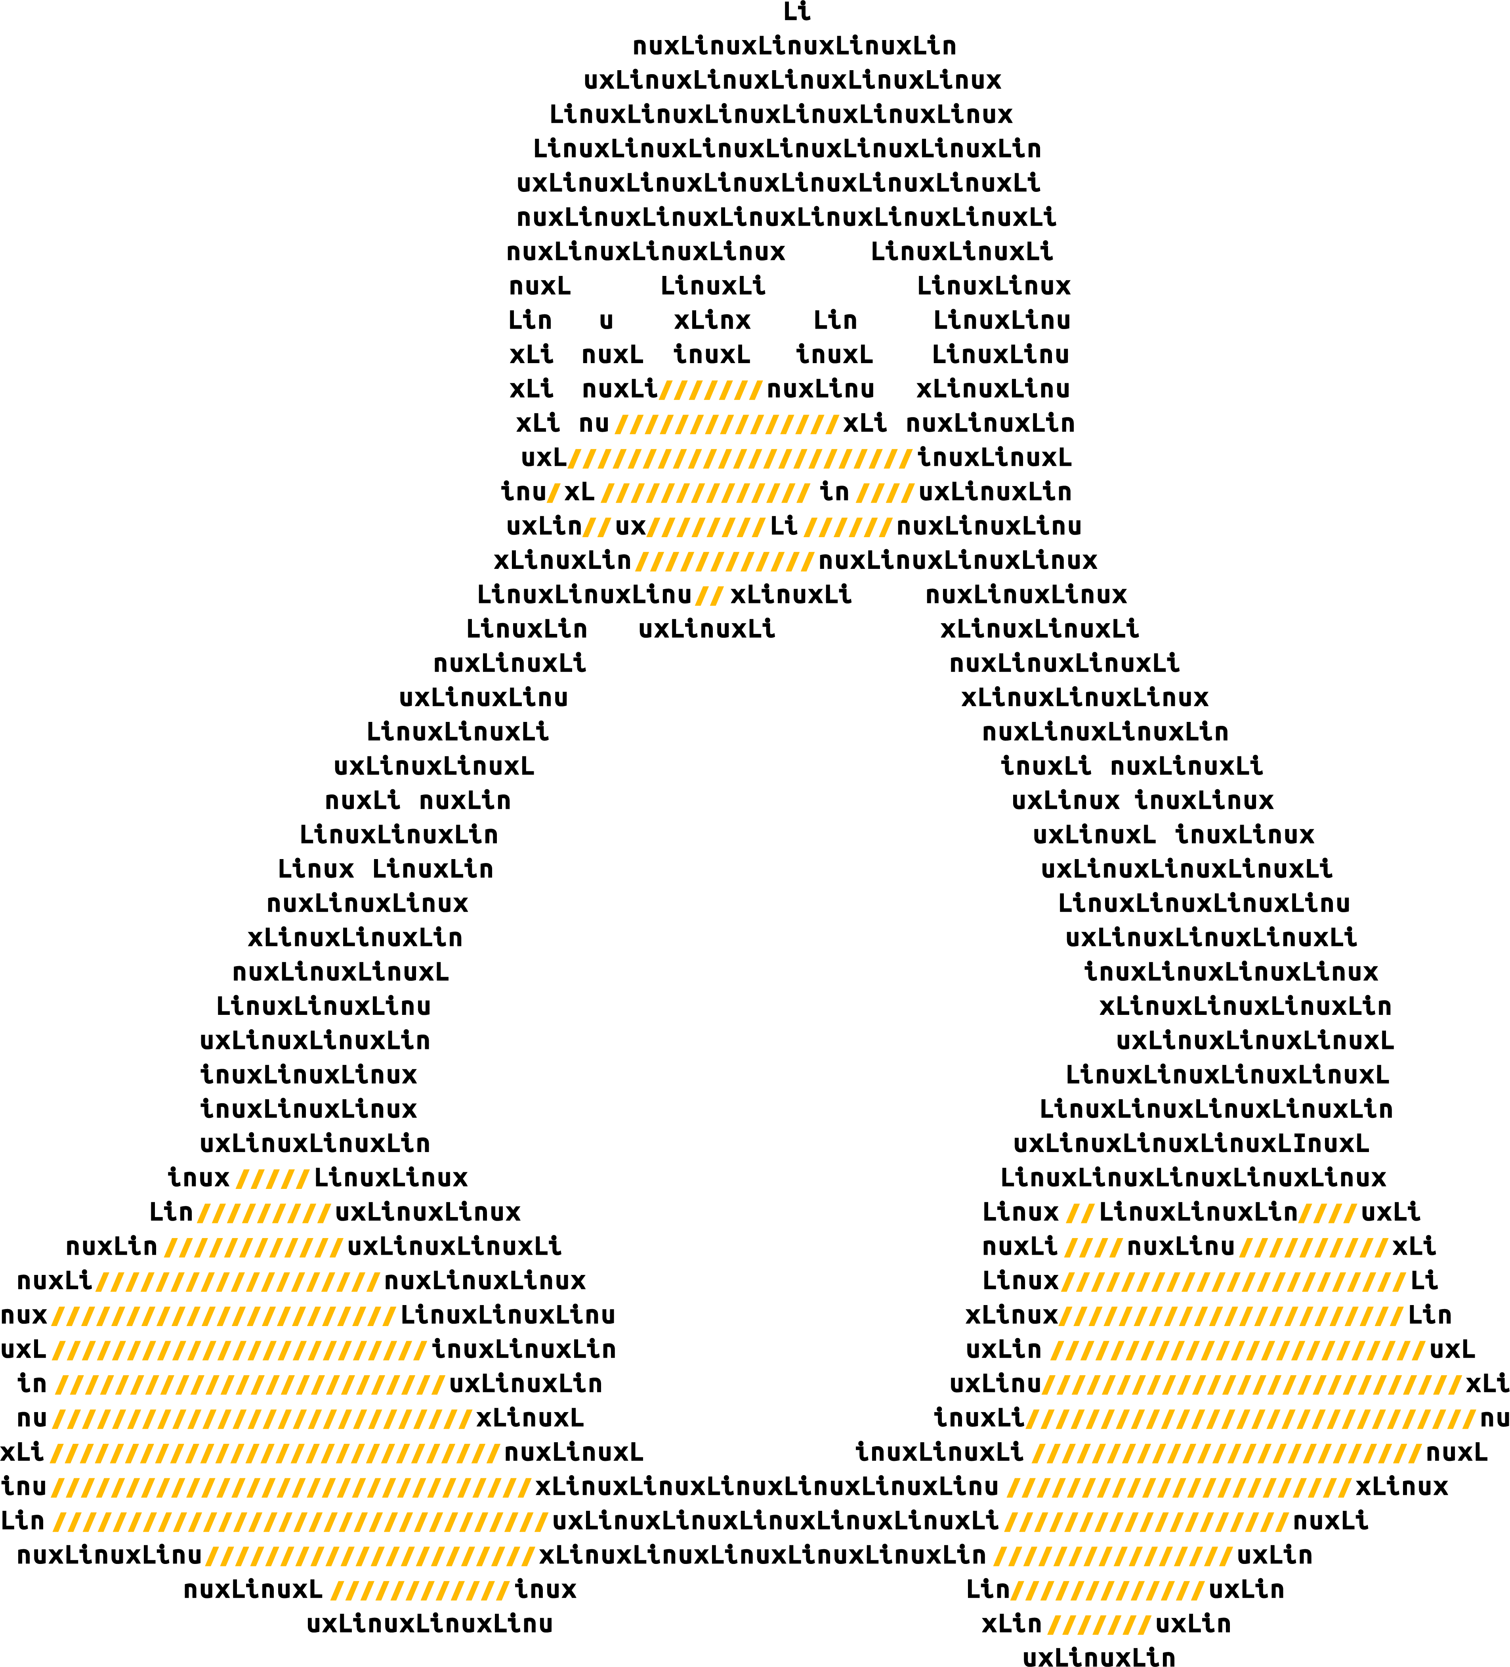
Open Azure Day
Digital event
November 18, 2020

Slide 2

Text layout (without bullet points)
Main topic: Segoe UI, size 28pt
Segoe UI, size 20pt for second level
Segoe UI, size 16pt for third level

Slide 3
Text layout (without bullet points)
Main topic: Segoe UI, size 28pt
Segoe UI, size 20pt for second level
Segoe UI, size 16pt for third level

Slide 4
Text layout (without bullet points)
Main topic: Segoe UI, size 28pt
Segoe UI, size 20pt for second level
Segoe UI, size 16pt for third level

Slide 5
Text layout (without bullet points)
Main topic: Segoe UI, size 28pt
Segoe UI, size 20pt for second level
Segoe UI, size 16pt for third level

